Slide 1
BANCASSURANCE TEAM PRESENTATION
Turnkey Africa Ltd

Slide 2
INTRODUCTION
Topics
EAR Deployments
Data Source Creation
Client Infrastructure

Slide 3
EAR Deployments
What is An EAR (Enterprise Application Archive)?
This is file format used by Java for packaging one or more modules into a single archive so that the deployment of the various modules onto an application server happens simultaneously and coherently.

Slide 4
EAR Deployments
Main Areas
Extracting EAR files
Configuration of EAR files
Deploying an EAR

Slide 5
Extracting EAR Files
1. Explode EAR file 2. Explode GisModel 3. Explode TQGIS/GIS.war

Slide 6
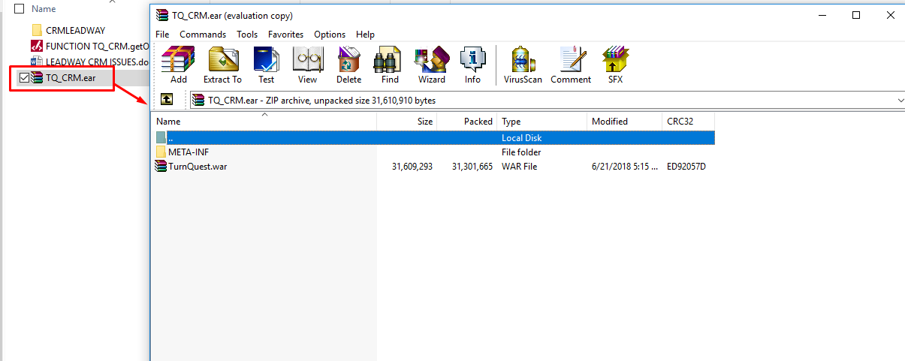
Extracting EAR Files
Create a subfolder inside the first folder with the same name. This results to two folders CRMLEADWAY>>CRMLEADWAY

Slide 7
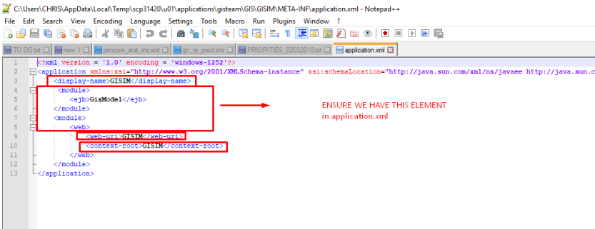
Configuring EAR Files
Key Notes;
Ensure the name represents the system (GISLIVE , LMSPROD)
The EAR names for Live and test environments should be different to avoid any confusion especially at clients sites
Rename the data source appropriately.
The Following are the files configured for a GIS EAR
Application.xml file ..GIS/META-INF/application.xml- Indicate the application name in the areas highlighted below

Slide 8
Configuring EAR files
2) Weblogic-ejb-jar.xml
..GIS/GisModel/META-INF/ Weblogic-ejb-jar.xml
3) bc4j.xcfg
..GIS/GisModel/tqgis/view/gismodel/login/common/ bc4j.xcfg
4) web.xml
..GIS/GIS/WEB-INF/web.xml
5) turnkey.hibernate.cfg
.. GISGIS/WEB-INF/classes/turnkey.hibernate.cfg
6) weblogic-ejb-jar.xml
.. GIS/GIS/WEB-INF/classes/META-INF/weblogic-ejb-jar.xml

Slide 9
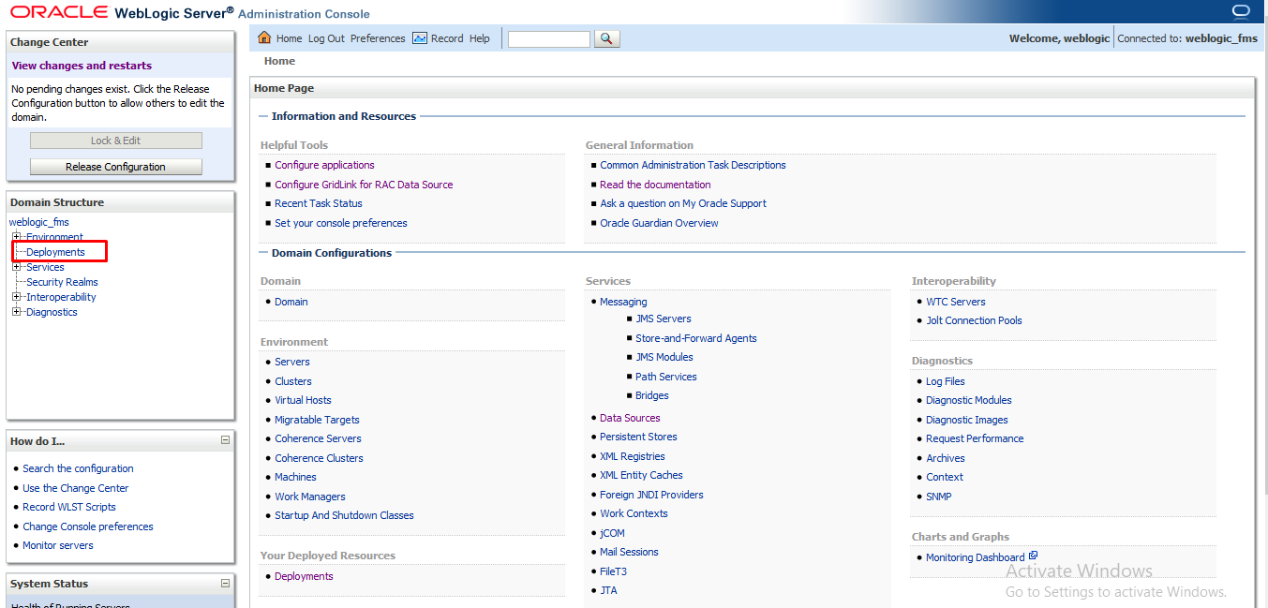
Deploying an EAR
While logged in to Weblogic server, click on deployments option under domain structure. See below screenshot

Slide 10
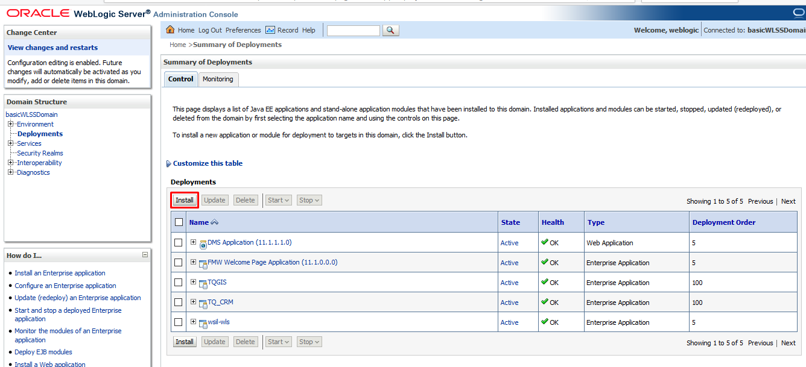
Deploying an EAR
On clicking the deployments link, the screen below is displayed. Click on the highlighted install button.

Slide 11
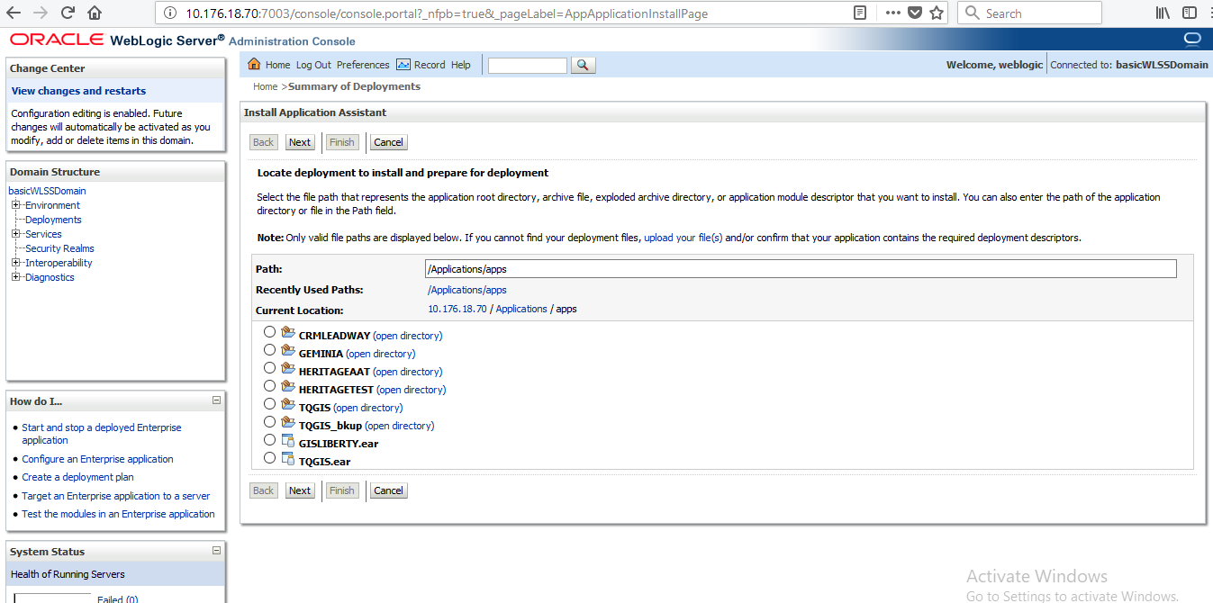
Deploying an EAR
Select the EAR to be deployed and click next

Slide 12
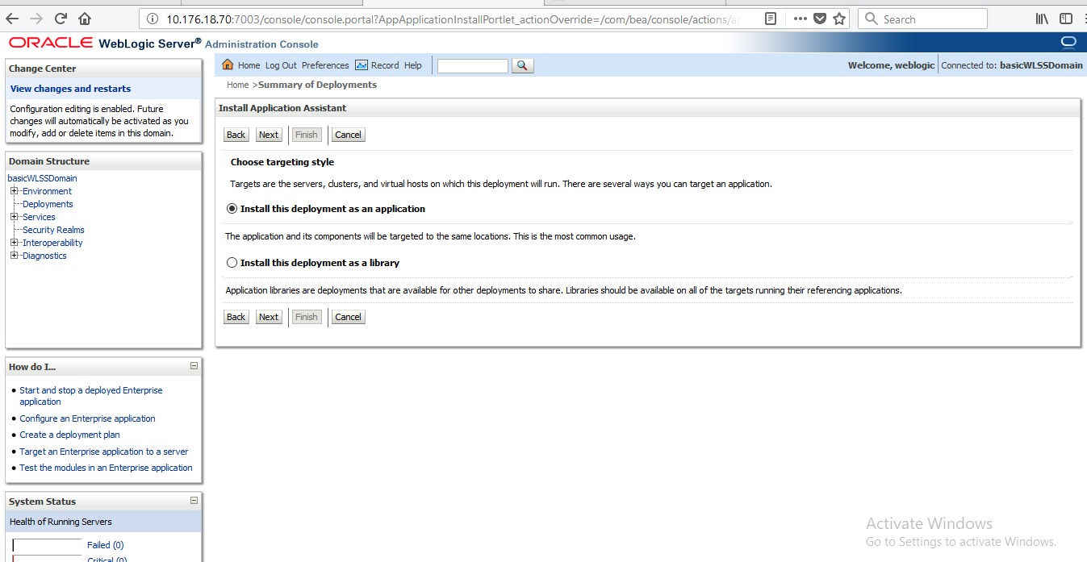
Deploying an EAR
Select the Install this deployment as an application highlighted below

Slide 13
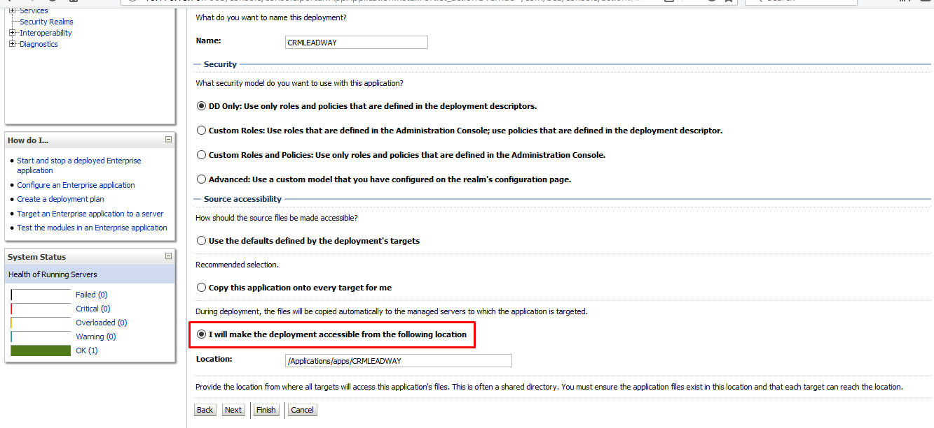
Deploying an EAR
Select the I will make the deployment accessible from the following location highlighted below. Ensure the highlighted option is checked

Slide 14
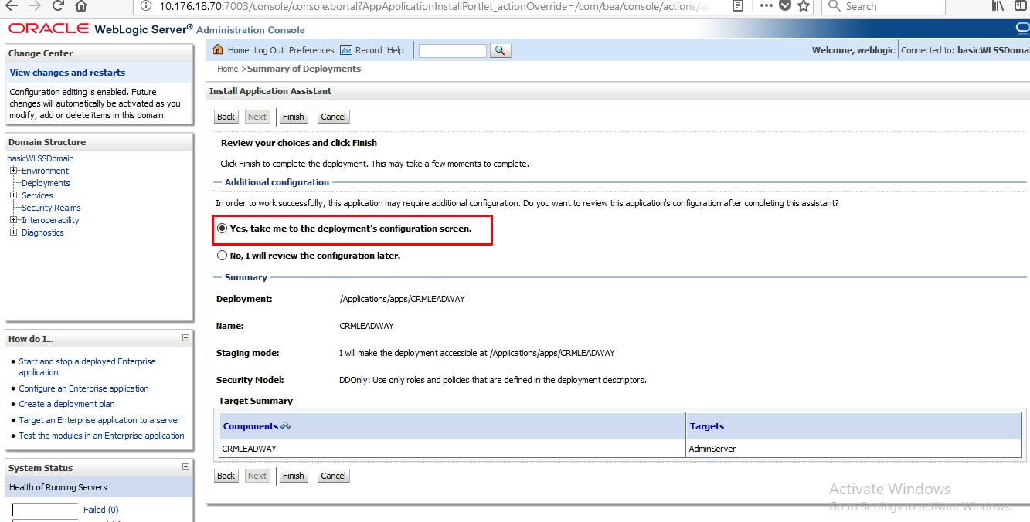
Deploying an EAR
On clicking Next, the screen below appears

Slide 15
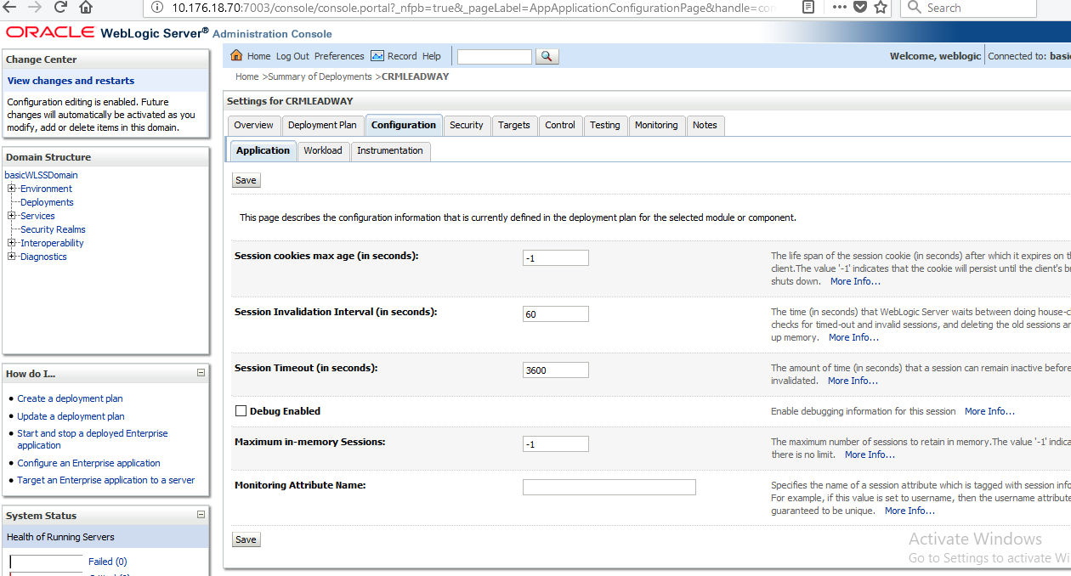
Deploying an EAR
Click on the finish button while on the above screen. The EAR is successfully deployed and the below screen is displayed

Slide 16
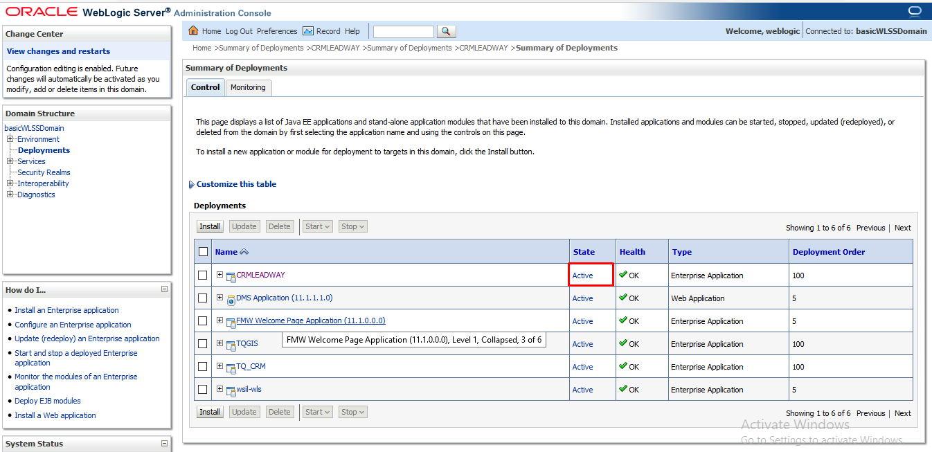
Deploying an EAR
To confirm if the EAR has been deployed successfully ,Click on the deployments link. The available EAR’s are displayed. If deployed successfully the Status column reads Active as shown

Slide 17
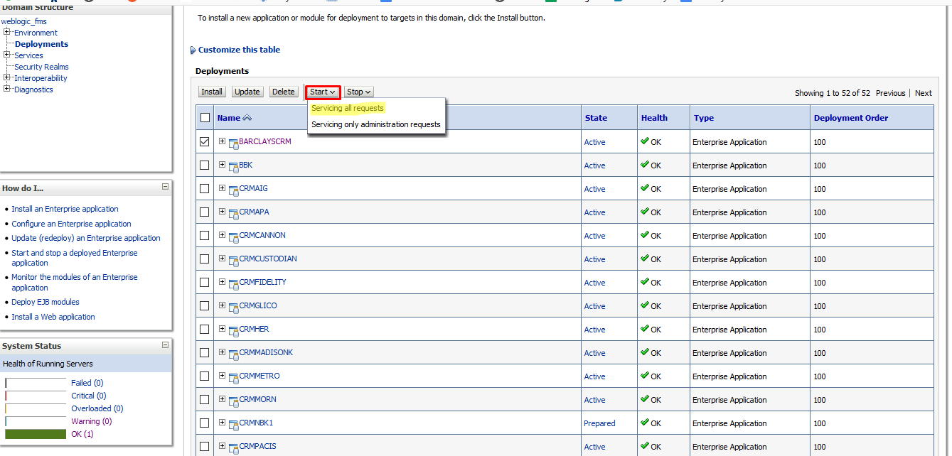
Deploying an EAR
Deployment status
Active
Prepared
Failed

Slide 18
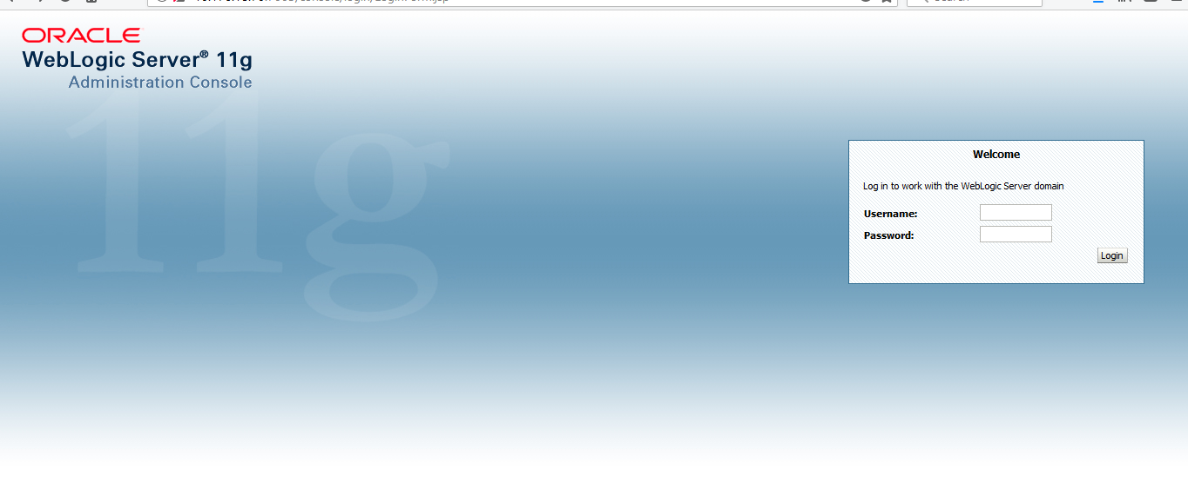
Creating a data source
The data source is created on the server where the EAR is placed e.g. if the EAR is on the server 10.176.18.37:7005 the WebLogic server url will be http://10.176.18.37:7005/console
Log in to WebLogic server. Provide username and password then click on login button

Slide 19
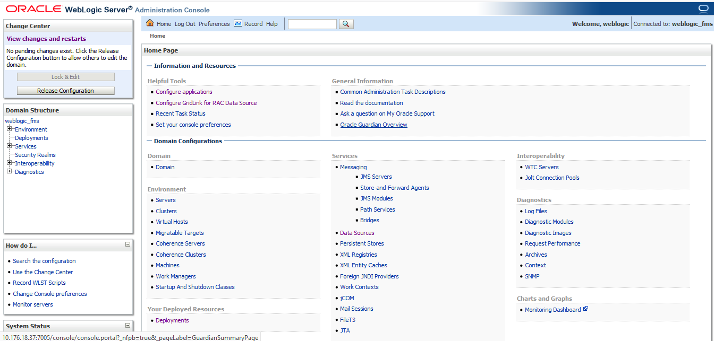
Creating a data source
WebLogic home screen shown below appears

Slide 20
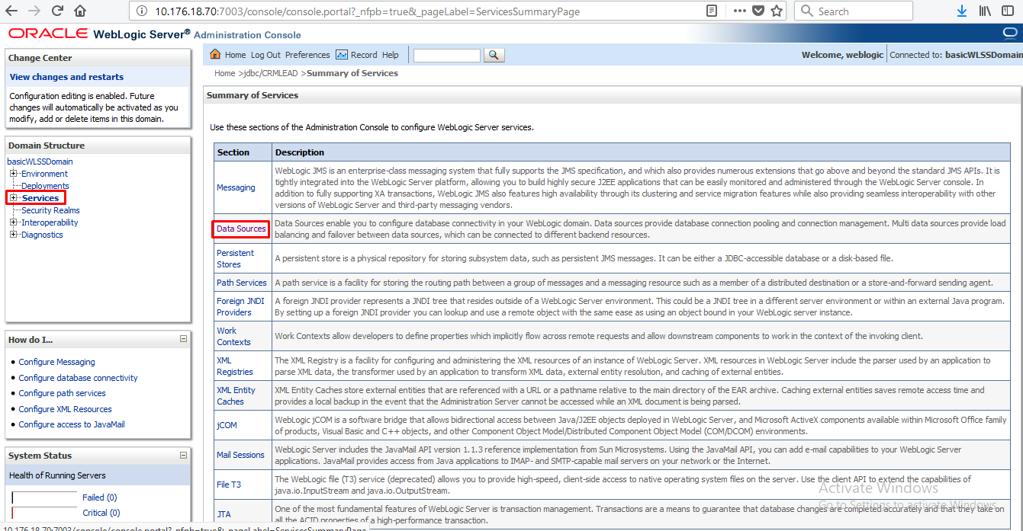
Creating a data source
Under Domain Structure, click on services then data sources as highlighted below

Slide 21
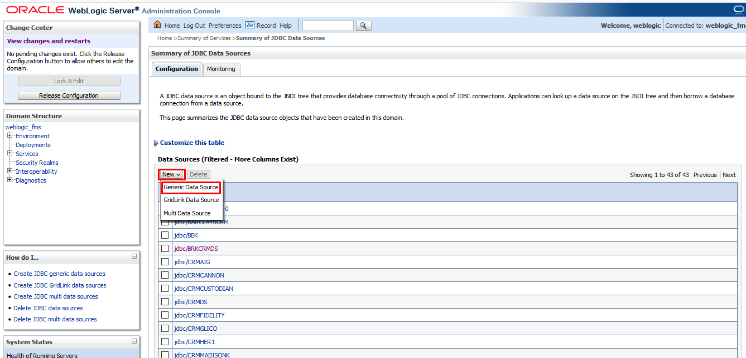
Creating a data source
On clicking data sources, the screen below is displayed. Click on the new button and select generic data source option as highlighted below

Slide 22
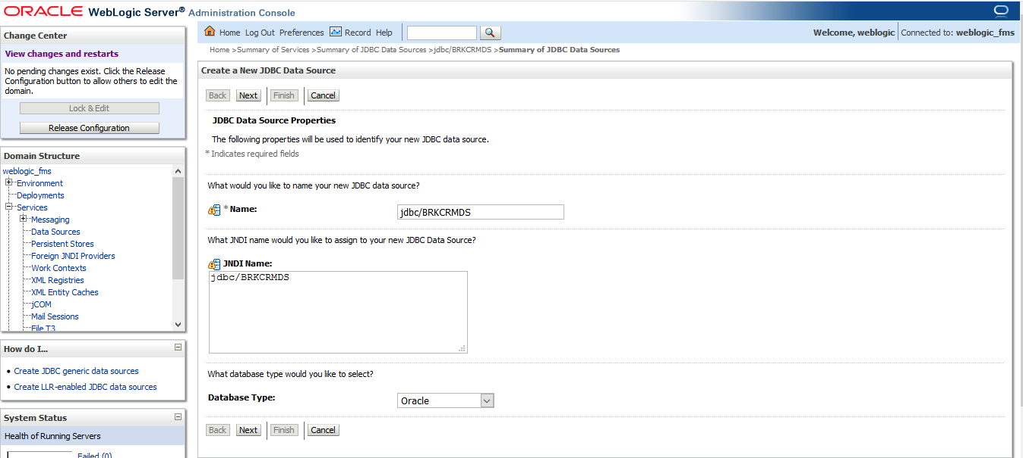
Creating a data source
The screen below is displayed. Enter data source name e.g. jdbc/BRKCRMDS, and copy the same to jdbc Name as shown below. The data source name should be the same as the one indicated on the EAR files.

Slide 23
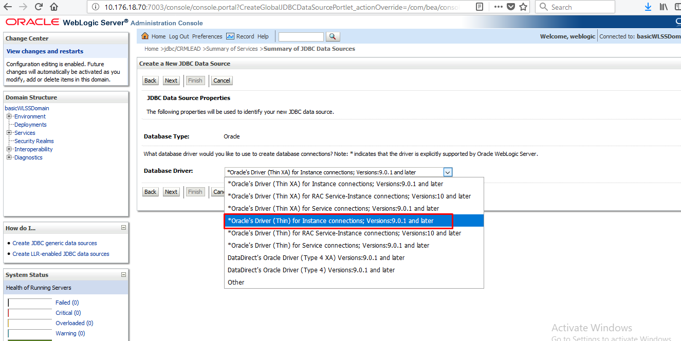
Creating a data source
Click next. The screen below is displayed. Select the option highlighted on the screenshot below for the Database driver and click next

Slide 24
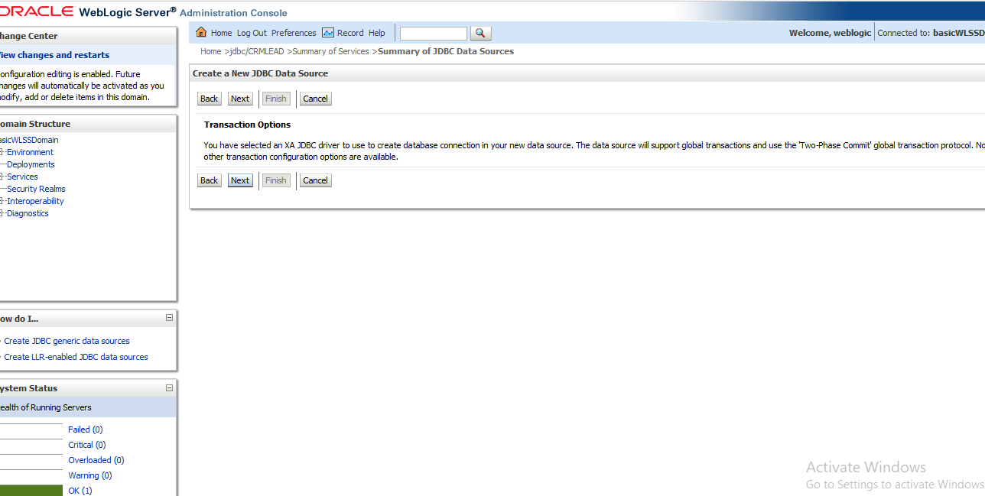
Creating a data source
On clicking next, the below screen is displayed

Slide 25
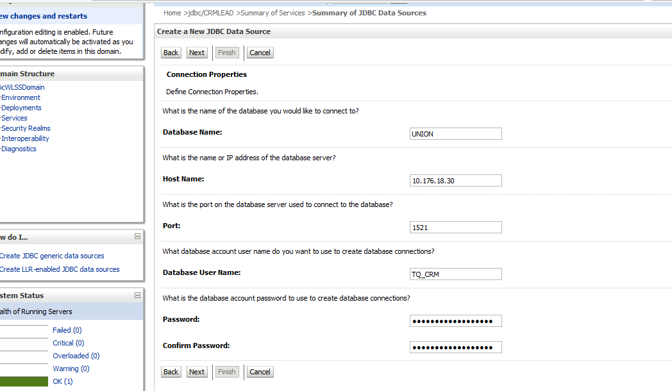
Creating a data source
Capture the below details

Slide 26
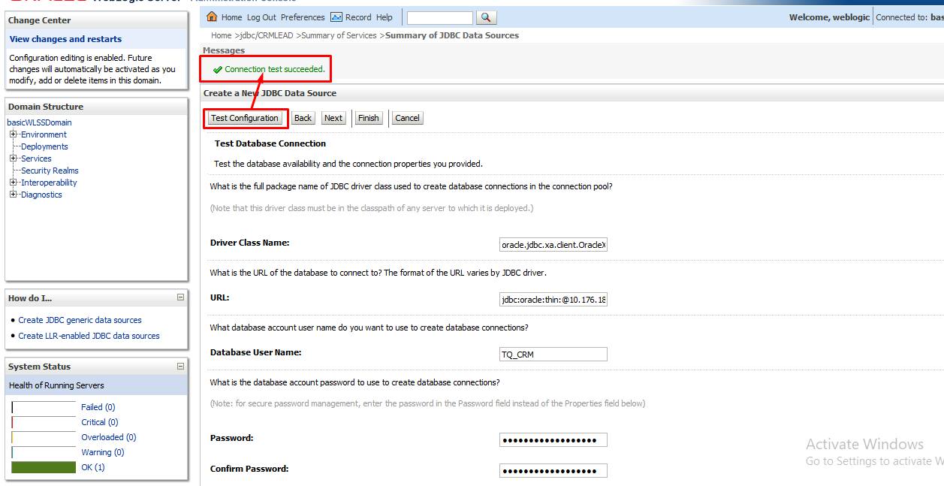
Creating a data source
Click on next button. The screen below is displayed. Click on test configuration button. The message Connection test succeeded should be displayed

Slide 27
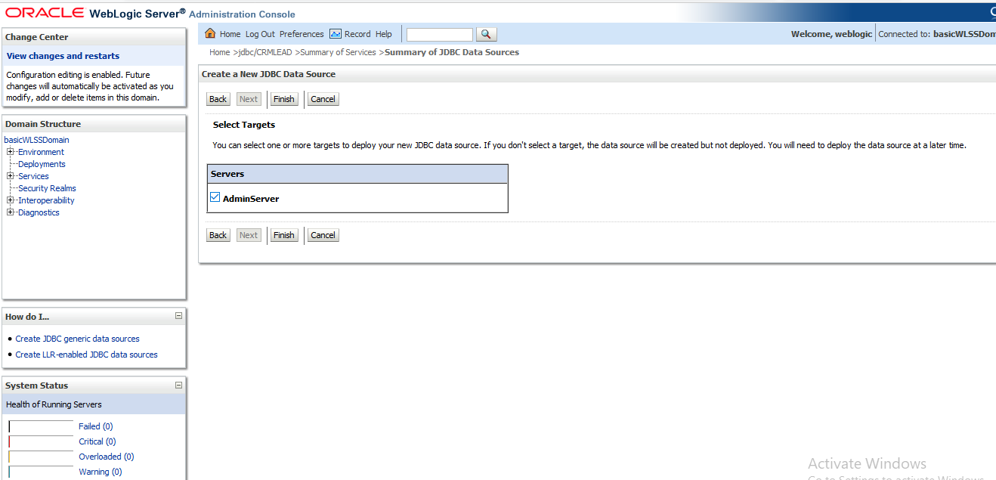
Creating a data source
Click next and check the admin server option under select targets

Slide 28
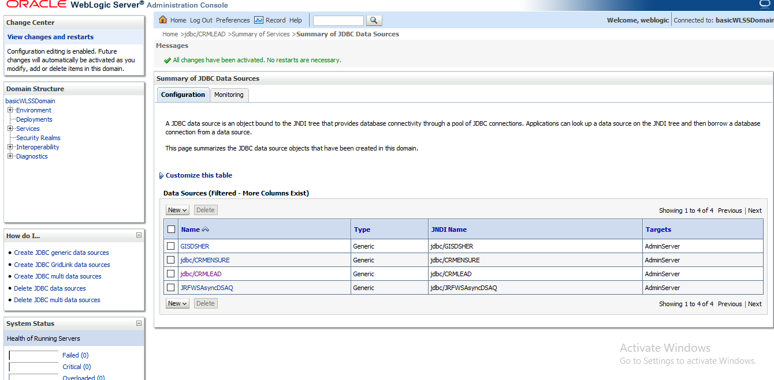
Creating a data source
Click on finish button. The result should be as below

Slide 29
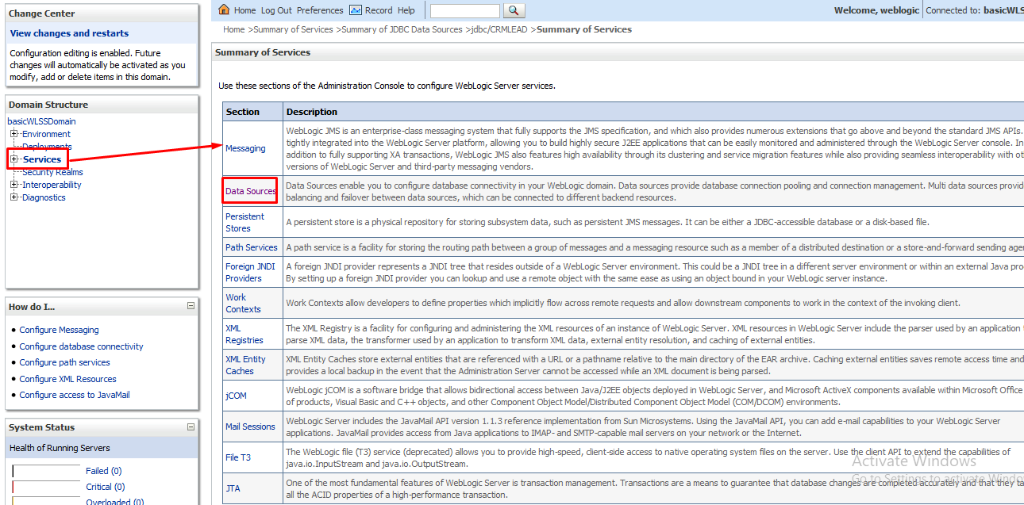
Configuring a data source
While logged into WebLogic server, click on services then data sources as shown below

Slide 30
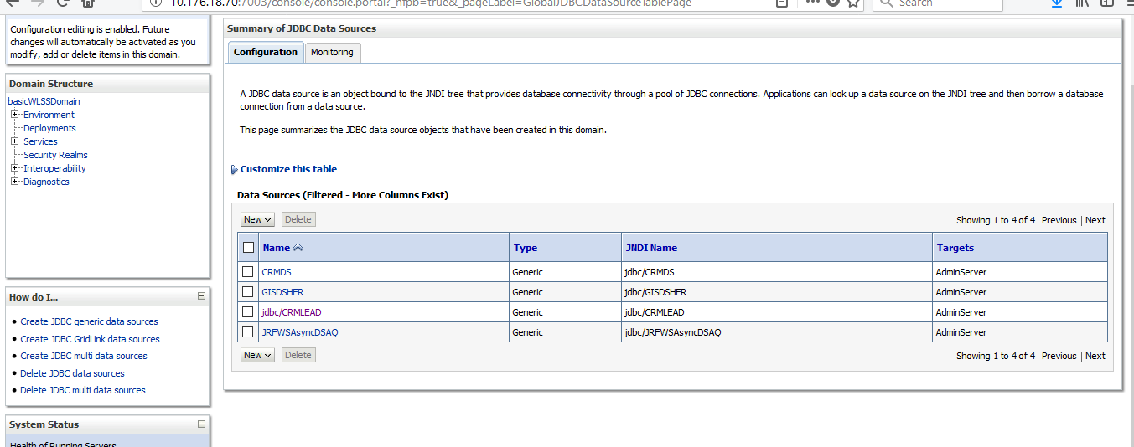
Configuring a data source
On clicking data sources, the screen below is displayed

Slide 31
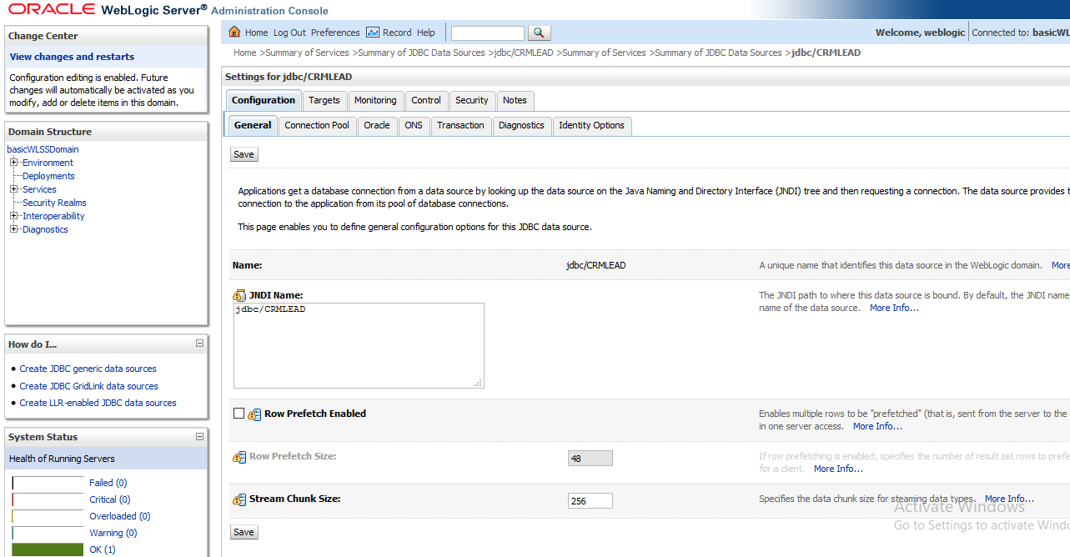
Configuring a data source
Click on the data source to be configured e.g. CRMLEAD.The screen below is displayed

Slide 32
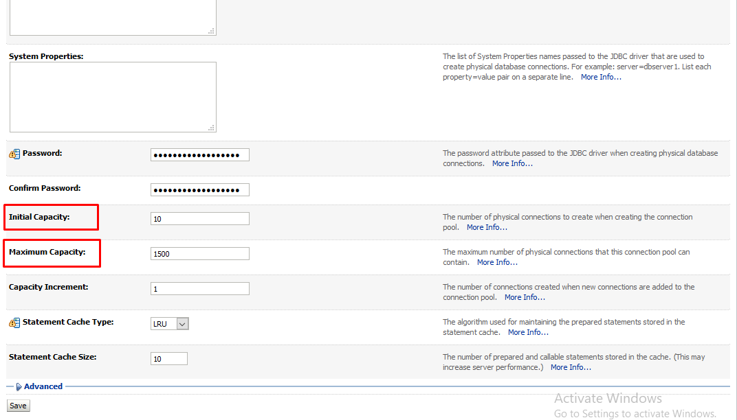
Configuring a data source
Click on connection pool tab and configure the below highlighted areas as on the screenshot and click save

Slide 33
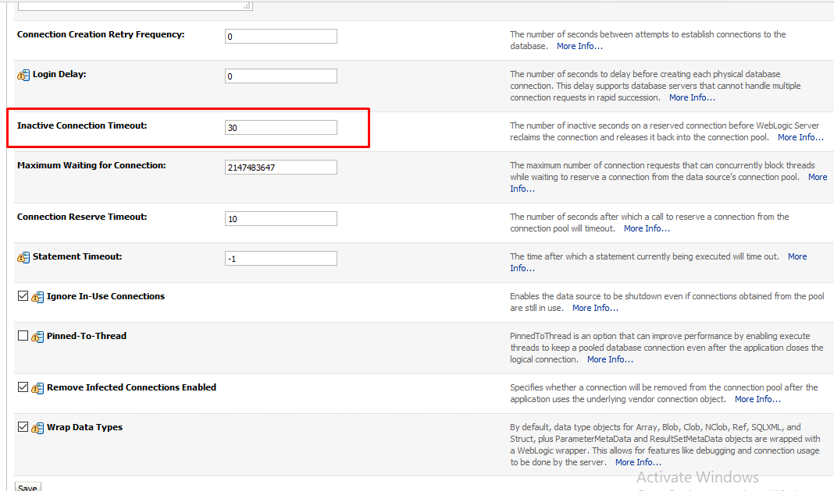
Configuring a data source
Click on the Advanced link on the bottom of the screen. The screen below appears. Confirm the inactive connection timeout is setup as below and click save

Slide 34
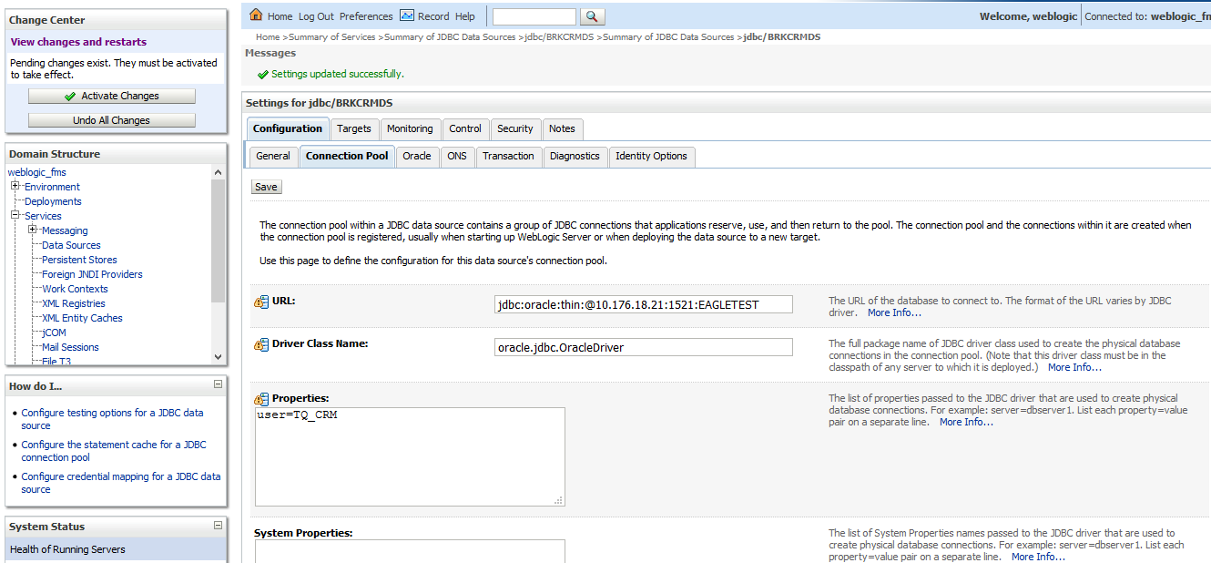
Configuring a data source
The data source is configured successfully

Slide 35
Client Infrastructure

Slide 36
The END

